Slide 1
What are you doing to help the environment?
Go back and look at the green promises you wrote on your green paper.
Remind each other about your promises and remember to monitor your progress as you check your activities.

Slide 2
Study the following pie charts
What uses the smallest amount of energy?
What uses the most energy?
Where does the most energy get lost?
Where does the smallest amount of energy get lost?
Think about how we could stop some of this energy from escaping.
Discuss with your partner.

Slide 3
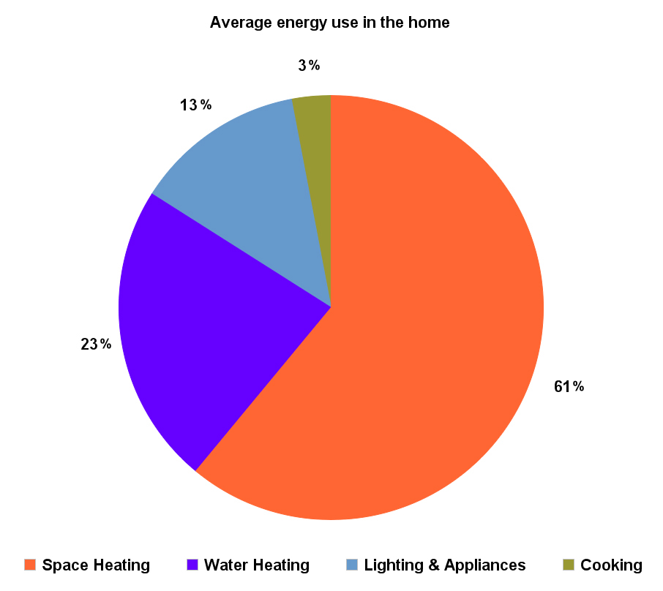
Study the following pie charts

Slide 4
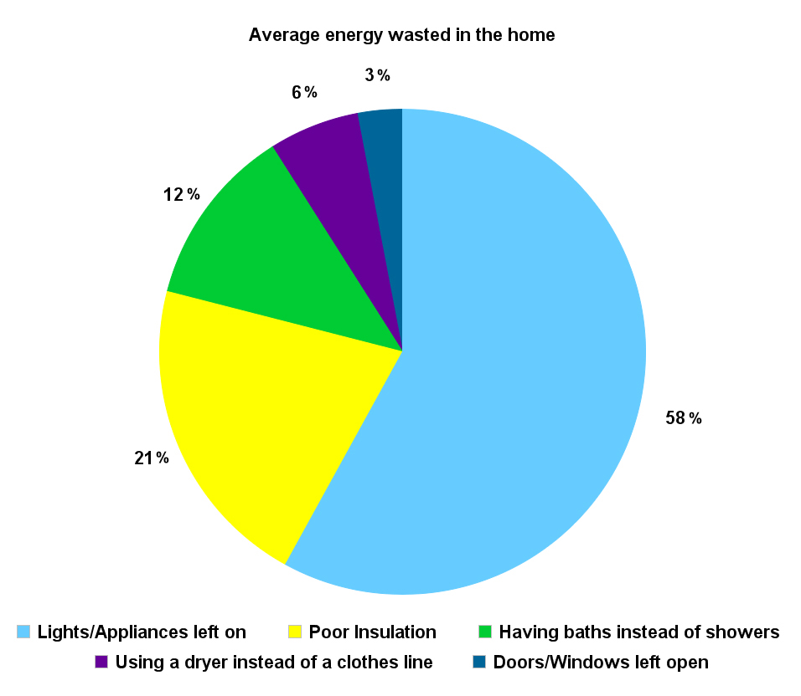
Study the following pie charts

Slide 5
So what’s Insulation? We can all reduce the transfer or loss of heat through insulation. Insulation is the material or technique used to reduce the rate at which heat is transferred.
Sheep grow thick wool to keep them warm on the hillside – the wool traps pockets of air, which is why we use it to make warm winter clothing for ourselves and to insulate our homes
By putting a tea cosy on a teapot, the heat loss from the tea inside is reduced
Thermos flasks, fridges and ovens all use insulation very effectively to conserve heat or prevent heat penetration to keep our food and drinks hot or cold
Birds fluff up their feathers in the winter to trap air in between to help insulate them from the cold
We can insulate our homes by adding insulated materials such as fibreglass, polystyrene, foam or wool or by installing double glazing or fitting carpets to reduce the heat loss through roofs, walls, windows, doors and floors. Making small changes, such as using draft excluders or closing blinds and curtains to keep houses cool in summer and warm in winter, all contribute towards insulating homes.

Slide 6
Insulating our homes and school will:
Save heat, keeping your warmer in winter and cooler in summer
Save money on energy bills.
Save the environment, by cutting our carbon footprints

Slide 7
Why are the following statements true? Discuss with your partner.
1 ) 10mm thickness of insulating material is better than 5mm thickness.
2 ) A door that allows a draft to seep through affects the effectiveness of insulating the home.
3 ) Insulating the attic space is just as important as insulating the walls and floor area.
4) Double glazing windows are a better insulator than single glazing windows.

Slide 8
Discuss with your partner if you think the following are true or false:
1 ) Insulation is good at keeping heat inside the house and cold air outside of the house.
2 ) Any drafts improve the effectiveness of insulation as it allows cold air to come into the home.
3 ) Heat rises and escapes through the ceiling / roof space if it is not insulated.
4) The space between double glazing window panels helps to increase the loss of heat.

Slide 9
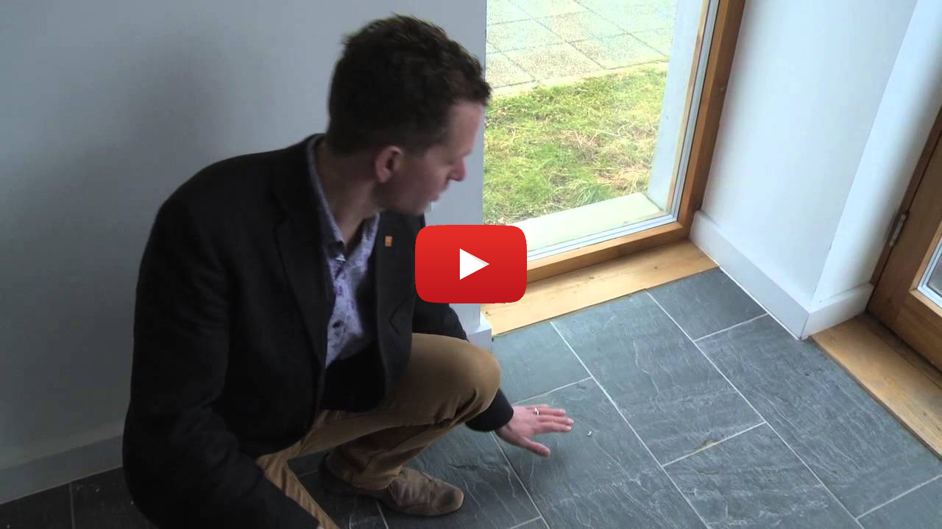
Energy Saving Homes: https://www.youtube.com/watch?v=7jmAxlpbO8A

Slide 10
Seeing the light! (Research Activity)
Find as much information as you can about:
Electric Bulbs
Try to find information to answer the following questions:
. Who invented the light bulb?
. When was the first bulb devised?
. What different types of bulbs are there?
. How is energy measured?
. How much energy do different types of bulbs use?
. How much do bulbs etc. cost?
Why don’t you start with a Gist grid?
Know Need to know Information Source

Slide 11
Shedding light on the matter!
Low-energy light bulbs use roughly 75% to 80% less energy than normal incandescent light bulbs!
They also last longer!
Calculate how many bulbs are in your home and in your school.
What sort of light bulbs are they?
Find out the price of the different kinds of light bulbs.
How much would it cost to put in low-energy bulbs in your home?
How much would it cost to put in low-energy bulbs in your school?

Slide 12
Seeing the light!
Discuss the points below:
* Light bulbs create heat when they are lit.
* It is a waste of energy for light bulbs to create heat!
* Low-energy light bulbs create less energy than normal light bulbs!

Slide 13
Warming Up
Low-energy light bulbs produce less heat than normal light bulbs.
Do you agree or disagree with this statement?
Give reasons.
Design an experiment to investigate the statement.
Consider:
How will you complete your experiment?
Which resources will you need?
Which components will you keep fixed?
Which components will you measure?
How will you record your results?

Slide 14
Change your bulbs!
Create an information pamphlet to persuade people to buy low-energy light bulbs.
Consider:
Effective persuasion skills.
Facts / information to share.
Pictures.
Your pamphlet layout.
Which computer program to use to create the pamphlet.

Slide 15
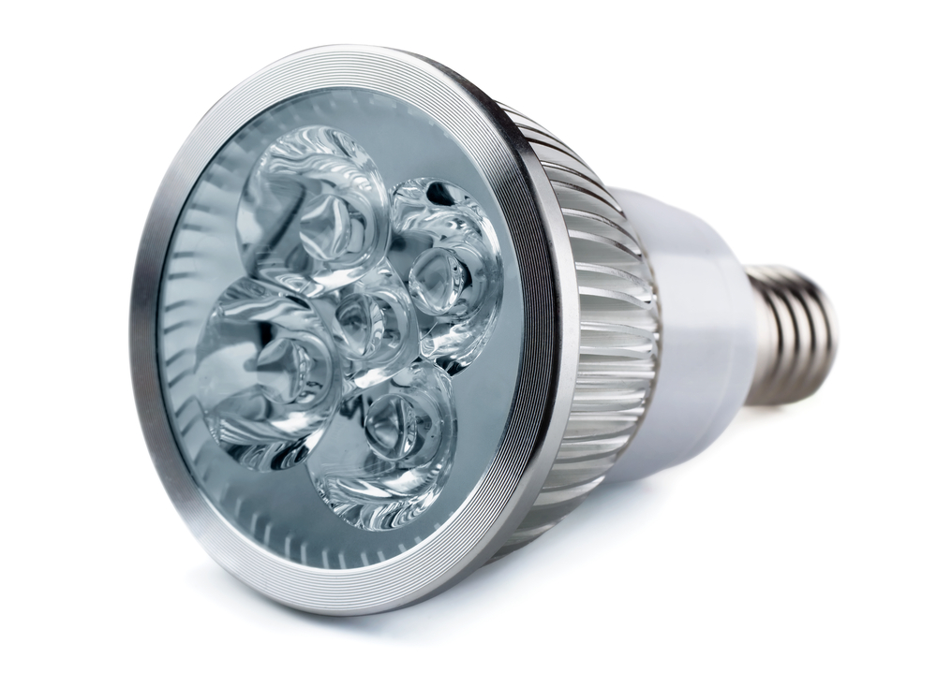
LED Lights
LED lights are being suggested as the future for lights in our homes as they use a very small amount of energy, they last a long time and they are bright as soon as they are turned on.
LED light bulbs are different to traditional light bulbs in the way that they produce light.
Old light bulbs work by passing electricity through a filament, while LEDs produce light by using semi-conductors that emit light energy when an electric current is passed through.
This is different to how energy-saving light bulbs create light, they pass energy through mercury vapour to create UV light which is then absorbed by a layer or phosphor inside the lamp causing it to glow with heat.

Slide 16
Seeing the light!
Design a light that turns on when someone opens the door to a room.
Decide on the type of circuit you will use.
Which electrical components will you need?
Design a light that turns on when
someone opens the door to a room.
What will hold the light and the circuit?
What materials will you need?

Slide 17
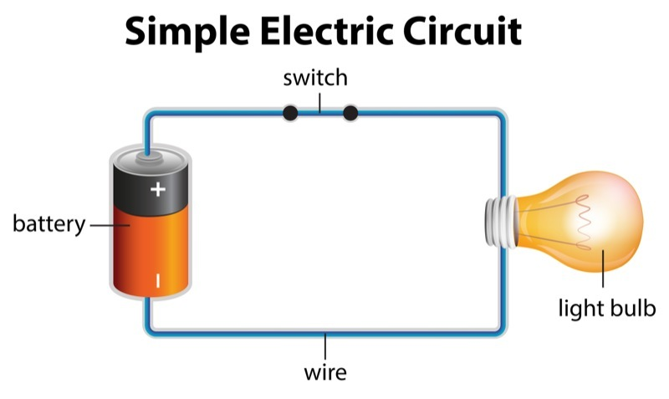
Seeing the light!
What is a circuit?
Every circuit needs a power source, like a battery, with wires attached to the positive (+) and negative (-) ends. A battery is known as a cell.
A circuit may also contain other electrical components such as bulbs, motors or buzzers, which allow electricity to pass through them. Electricity will only travel around a completed circuit. This means that the circuit must not have gaps.

Slide 18
Seeing the light!
A light that turns on when someone opens the door to a room!
Evaluate
Does the circuit work:
Very well
By accident
Not at all
How could you improve this circuit?
Is the lamp / bulb holding structure effective?
Is it appealing?

Slide 19
Nothing’s Dark!
Design and create a light for a child’s bedroom that lights up as it gets dark.
Things to discuss as a group:
What kind of circuit will you need?
What sensors should you use?
What will hold the circuit?
Will it be appealing to a small child?

Slide 20
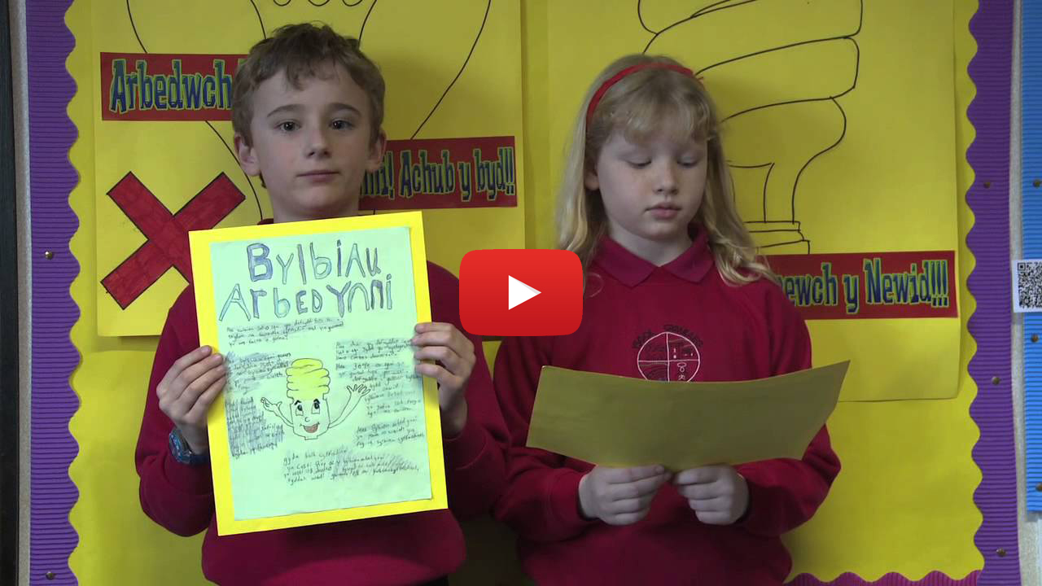
Change your ways!
Light Bulb Posters: https://www.youtube.com/watch?v=Zheb7HRfyuA

Slide 21
Counting the cost!
Electricity is measured in Watts or Kilowatts.
Electricity companies measure how many units of electricity you use and charge you per unit used.
The cost for one unit of electricity at the moment is 10.7 pence!
How much would the following number of units cost?
100 unit?
150 unit?
200 unit?
330 unit?
500 unit?

Slide 22
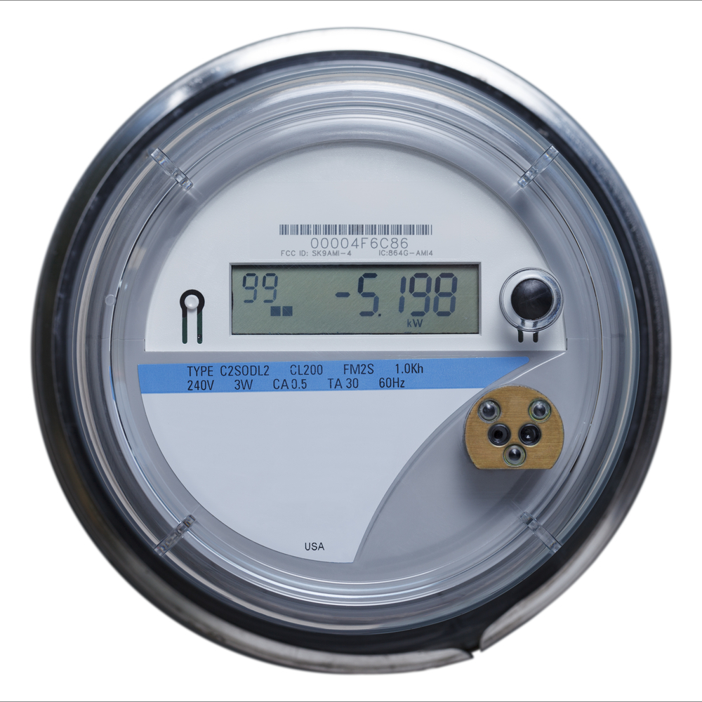
Counting the cost!
Smart meters are modern versions of the meters for gas and electricity that are in your homes at the moment.
Smart meters will show information about the electricity and gas you are using, including its price and how much CO2 it’s releasing. This information could help you to lower your energy use.

