Slide 1
The Hunchback in the Park
Dylan Thomas

Slide 2
Lesson 1: The Hunchback in the Park
Learning Objectives
By the end of the lesson I will:
have made suitable annotations and considered the presentation of the hunchback

Slide 3
Class reading of the poem
Task 1: Discuss in pairs
Identify the perspective of the poem- whose voice is it?
the hunchback’s
a schoolboy’s
the park keeper’s
a different character/persona
Why do you think this?

Slide 4
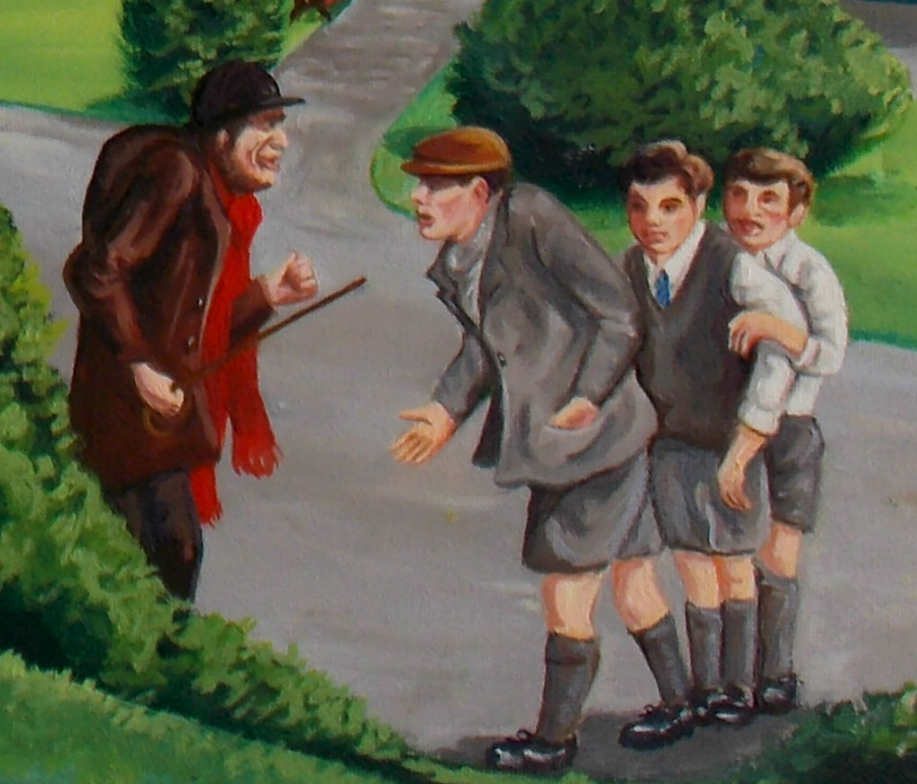
Setting: Look at the images below:
In Pairs: Discuss what type of person you think is presented in the images.

Slide 5
What is a hunchback?
Definition:
“A back deformed by a sharp forward angle, forming a hump, typically caused by collapse of a vertebra.”
Re-read the poem
Discussion Questions:
Why do you think Thomas chose for his protagonist to be a ‘hunchback’?
What impact do you think this has on the message of the poem?
To what extent do you think Thomas is trying to reflect the views of society here?

Slide 6
Task: Worksheet 1
Complete the tasks on ‘Worksheet 1’

Slide 7
Lesson 2: The Hunchback in the Park
Learning Objectives
By the end of the lesson I will:
- have a better understanding of the term ‘imagery’ and be able to apply this knowledge in my discussion of the poem.

Slide 8
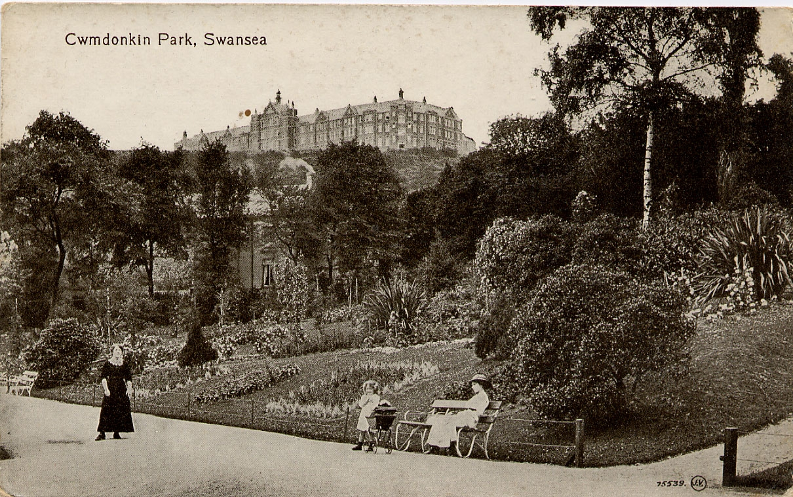
Cwmdonkin Park

Slide 9
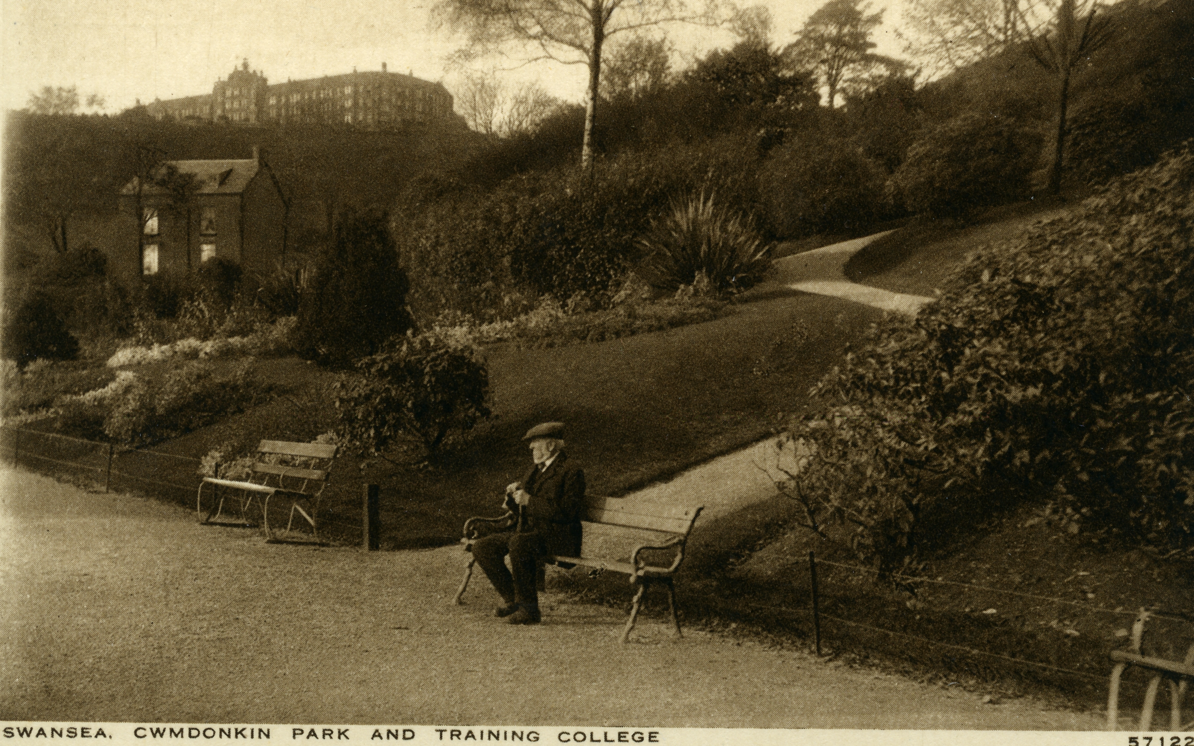
Cwmdonkin Park

Slide 10
‘The Hunchback in the Park’ was heavily influenced by Dylan Thomas’s experiences of Cwmdonkin Park in Swansea, which was close to the house where he was raised. In a BBC broadcast Thomas spoke about how he viewed the park a magical space where his imagination would be set free:
Cwmdonkin Park: Thomas’s imaginary world
“That small world widened as I learned its secrets and boundaries, as I discovered new refuges and ambushes in its woods and jungles, hidden homes and lairs for the multitudes of imagination, for cowboys and Indians and the tall, terrible half-people who rode on nightmares through my bedroom.”

Slide 11
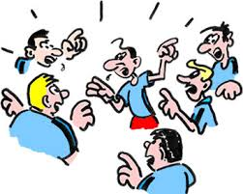
Think ~ Pair ~ Share What is imagery?
Individually: Consider the term ‘imagery’ and what you believe it means.
In Pairs:
Discuss the term with your partner.
Read through the poem and find an example of Thomas’s use of sensory description.
Share your findings as a class

Slide 12
The five senses:
Imagery is the author’s use of language that appeals to the five senses in order to help the reader imagine what being described.

Slide 13
Task: Worksheet 2
Complete the tasks on ‘Worksheet 2’

Slide 14
Lessons 3 and 4 Task: Workbook
Complete the tasks in the workbook on the poem.
Lesson 5 Task: Annotation
Class reading and annotation of the poem.

Slide 15
Lesson 6: Preparing for main activity
What is your response to the way the hunchback is presented in the poem? Do you feel sympathy towards him? Discuss the way that Thomas presents him using evidence from the text to support your view.
Point | Evidence | Explanation
Helpless
Lonely
Proud
Neglected
Isolated
Copy the table into your exercise books and complete it by finding quotations to support each point.

Slide 16
Success Criteria
Success Criteria
(PEE) PEE;
(AN) Analyse the poem in detail;
(QU) Select relevant quotes;
(IM) Analyse imagery;
(SS) Vary your sentences;
(EX) Develop your explanations;
(KW) Use the keywords given;
(WP) Refer to specific words and phrases;
(CX) Put the poem in context of background;
(ST) Structure your essay logically.
Note: Lines are never sentences and stanzas/ verses are never paragraphs in poetry.

