Slide 1
‘A Refusal to Mourn the Death, by Fire, of a Child in London’ by Dylan Thomas
Lesson 6 Overview:
By the end of this lesson, I will:
Form my own opinion about the poem
Understand the main theme of the poem and how it is discussed.

Slide 2
Lesson 6 Resource Sheet Task 1
Class discussion – personal response to the poem
Complete Task 1 on Resource sheet.
We liked… The poem’s strengths | We disliked… The poem’s weaknesses

Slide 3
Lesson 6 Resource Sheet Task 2 – Classwork
Consider what are the main themes of this poem.
Which of these themes is the most important, in your opinion?

Slide 4
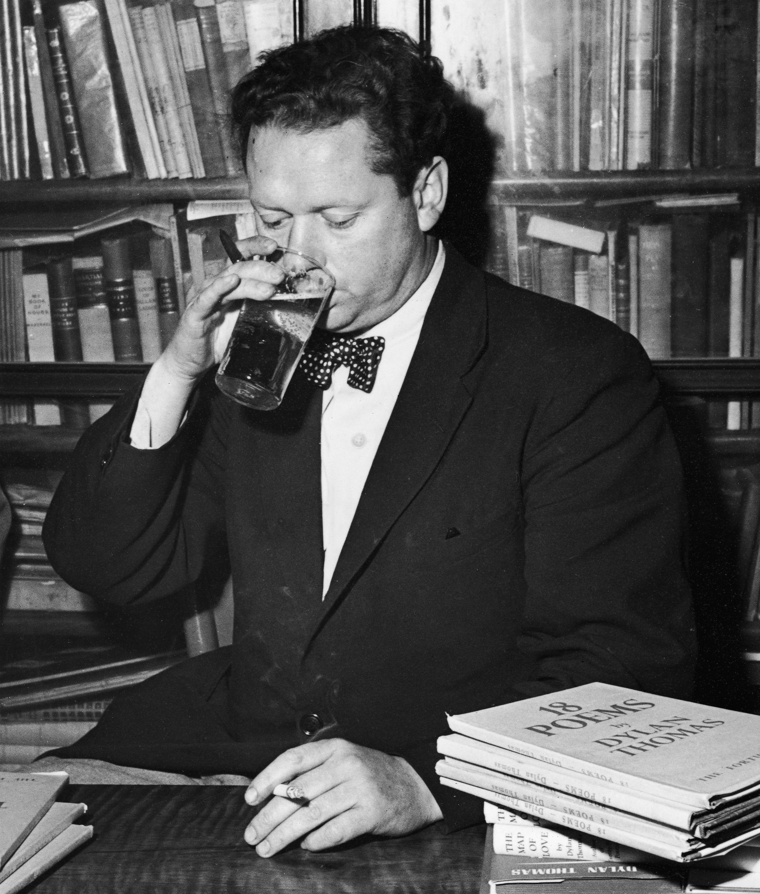
Dylan Thomas and the theme of death (1)
Death is a theme which is central to many of Dylan Thomas’s poems.
His health was poor and he also had an unhealthy lifestyle – drinking and smoking.

Slide 5
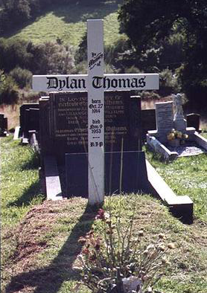
Dylan Thomas and the theme of death (2)
His father had always said that he would die before he was forty. In fact, Dylan Thomas died when he was 39 years old.

Slide 6
Dylan Thomas and the theme of death (2)
Although Dylan Thomas was afraid of death, his poems often had a positive attitude towards it.
His most famous poems on the theme of death include: ‘Do not go gentle into that good night’ and ‘And Death Shall Have No Dominion’.

Slide 7
Lesson 6 Resource Sheet Task 3 – Pair work
Point | Evidence – a few quotations from the poem | Explanation – How? Why?
Dylan Thomas refuses to mourn the child’s death as people usually do.

Slide 8
Lesson 6 Resource Sheet Task 3 – Pair work – Exemplar Answer Q.3
Point: The poet sees the child’s death as something important, or even sacred.
Evidence:
1. Thomas refuses to mourn the child’s death, as the poem’s title affirms.
Explanation:
For the poet, the child is not just another war casualty and he elevates her death, giving it special importance . Therefore, mourning the child’s death would make it seem banal and trivial.
Evidence:
2. Thomas refers to ‘The majesty and burning of the child’s death’.
Explanation:
The poet views the child’s death as majestic (magnificent, stately and grand). It is bright (burning here is also refers to how the child died). It is therefore something important.

Slide 9
Lesson 6 Resource Sheet Task 3 – Pair work – Exemplar Answer Q.3
Evidence:
3. The poet uses Biblical references, e.g. ‘I shall not murder her going with a grave truth’.
Explanation:
The poet refuses to mourn using traditional means, such as uttering a serious funeral speech about her until the end of the world and he himself has become a part of the natural world’s cycle of life and death.

